Slide 1
Judgment and Decision Making in Information Systems
Introduction:
Decision Analysis and
Human Judgement
Yuval Shahar, M.D., Ph.D.

Slide 2
Decision Making
Life involves making decisions!
  Decision makers require guidelines and expert support
Most important decisions involve
  multiple uncertainties
  multiple outcomes, which can often be evaluated using multiple attributes
  Multiple decision-making stages
  information gathering at every stage
Examples in everyday life include business, government policy, medicine, law, and personal decisions

Slide 3
Decision Analysis
Requires modeling the decision
  Several effective graphical modeling methods
Provides tools for quantitative analysis of decisions with multiple uncertainties and/or conflicting objectives
Provides decision makers with insight, not necessarily a solution
  Example: Multi-way sensitivity analysis
Benefits from using computational tools

Slide 4
Decision Models
Normative models
  Von-Neumann and Morgenstern Game Theory
  Decision Trees
  Influence Diagrams
  Belief Networks
  (Markov Models)
Descriptive models
  “Rational” axioms are often violated in practice
  Fallacies and biases in human decision making and judgment
  Prospect theory (Tversky and Kahnemann)

Slide 5
Decision Making in Medicine: a Typical Example
A 35 yrs old patient has Hodgkin's Lymphoma, probably (80%) stage II by physical examination and X-rays
She needs to decide with her doctor which of the following options she should chose:
  start radiotherapy immediately (typical stage II therapy)
  start chemotherapy immediately (typical stage III therapy; implies more side effects)
  undergo explorative laparotomy (a major operation that explores the abdominal cavity) to find out if she has stage II or stage III disease, then decide on radiotherapy or chemotherapy, using the new information

Slide 6
Personal Decision Making:
The Party Problem
Joseph K. invites his friends to a party, but needs to decide on the location:
  Outdoors (O) on the grass (completely open)
  On the Porch (P) (covered above, open on sides)
  Inside (I) the living room
If the weather is sunny (S), outdoors is best, followed by Porch and Indoors; if it rains (R), the living room is best, followed by Porch and Outdoors

Slide 7
Rules of Actional Thought
Ronald Howard’s version of the decision making axioms proposed by John von Neumann and Oscar Morgenstern in their classic work on game theory (1944, 1947)
Simple, intuitive guidelines to follow when making decisions
A set of five rational, consistent rules for a normative decision maker to follow

Slide 8
The Probability Rule
Decision makers use elemental and compound possibilities (e.g., rain; Sun & Porch) and probabilities to provide distinctions and information that characterize deals
  The clarity test: Crucial for making clairvoyance meaningful and useful
  Relevance of events
  Mutual exclusion of elemental possibilities
  Collective exhaustion of elemental possibilities

Slide 9
The Order Rule
Prospects (values of outcomes of deals) can be arranged in a (weakly) descending order from best to worst
The order of prospects is consistent and transitive
  A>B, B>C, => A>C
  Nontransitive orders lead to a “money pump”

Slide 10
The Equivalence Rule
If A>B>C, then there is a number 0<p<1 such that the decision maker is indifferent between getting prospect B for sure, and receiving a deal with probability p of getting A and probability 1-p of getting C
  P is the preference probability of this model
  B is the certain equivalent of the A,C deal

Slide 11
Preference Probabilities
1
P
A
B
≡
1-P
C

Slide 12
The Substitution Rule
The decision maker has to be indifferent between receiving a prospect and any deal for which that prospect is a certain equivalent
  B can be substituted for the A,C deal in any situation
  Implies treatment of preference probabilities as probabilities that might lead to action

Slide 13
The Choice Rule
If the prospect ordering includes D>E, and there are two deals with outcomes D,E, the decision maker must prefer the deal in which the probability of getting D is higher
  The only specific-action rule
  Simply states that decision makers follow their preferences, whatever these are

Slide 14
Decision Modeling by
Decision Trees
A convenient way to explicitly show
  the order and relationships of possible decisions
  Uncertain (chance) outcomes of decisions
  outcome results and their utilities (values)
Enable computation of the decision that maximizes expected utility

Slide 15
Decision Trees Conventions
Decision
node
Chance
node
Result
node
Information link
Influence link

Slide 16
The Party Problem Decision Tree
S
R
O
S
P
R
I
S
R

Slide 17
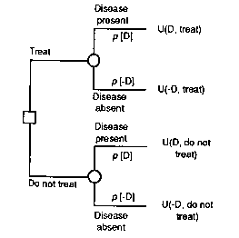
A Generic Decision Tree for a Medical Therapy Decison

Slide 18
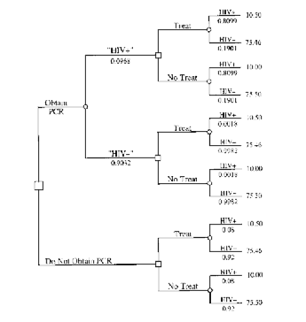
Decision Trees: an HIV Example
Decision node
Chance node

Slide 19
Decision Modeling by Influence Diagrams:
Node Conventions
Chance node
Decision node
Utility node

Slide 20
Link Semantics in Influence Diagrams
Dependence link
Information link
Influence link

Slide 21
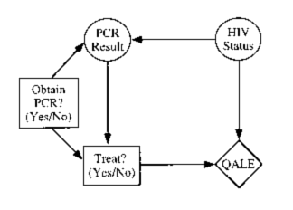
Influence Diagrams:
An HIV Example

Slide 22
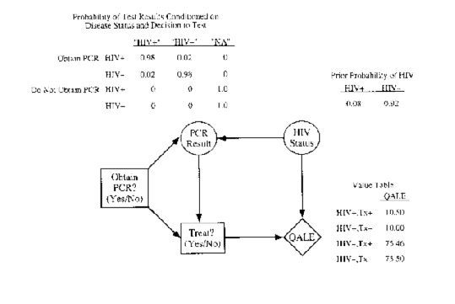
The Structure of Influence Diagram Links

Slide 23
Belief Networks
(Bayesian/Causal Probabilistic/Probabilistic Networks, etc)
Influence diagrams (DAGs) without decision and utility nodes
Disease
Gender
Sinusitis
Fever
Runny nose
Headache

Slide 24
Link Semantics in Belief Networks
Dependence
Independence
B
Conditional independence of B and C, given A
A
C

Slide 25
Advantages of Influence Diagrams and Belief Networks
Excellent modeling tool that supports acquisition from domain experts
  Intuitive semantics (e.g., information and influence links)
  Explicit representation of dependencies
  very concise representation of large decision models
“Anytime” algorithms available (using probability theory) to compute the distribution of values at any node given the values of any subset of the nodes (e.g., at any stage of information gathering)
Explicit support for value of information computations

Slide 26
Disadvantages of Influence Diagrams and Belief Networks
Explicit representation of dependencies often requires acquisition of joint probability distributions (P(A|B,C))
Computation in general intractable (NP hard)
Order of decisions and relations between decisions and available information might be obscured

Slide 27
Examples of Successful
Belief-Network and/or
Influence Diagram Applications
In clinical medicine:
  Pathological diagnosis at the level of a subspecialized medical expert (Pathfinder)
  Endocrinological diagnosis (NESTOR)
In bioinformatics:
  Recognition of meaningful sites and features in DNA sequences
  Educated guess of tertiary structure of proteins

Slide 28
Markov Models
A probabilistic version of finite state machines/automata (FSM/FSA) where each node is a variable in the probability space
Each variable is independent of its predecessors, given its parents
A common method for simulation of changes of state over time
P_{1,2}
P_{2,3}
S₁
S₂
S₃
P_{2,1}

